Slide 2
ABOUT DÈ BÕX
Dè Bõx is a business process and strategy consulting company that uses technology to deliver impactful and sustainable results by "Thinking out of the box".
At Dè Bõx we strongly believe that future belongs to the organizations that seamlessly connect business processes and business strategy through a robust IT enabled platform, and therefore we help our clients doing that precisely.

Slide 3
IT PRODUCTS
A Complete CRM Specially Designed for Travel Industry
Comprehensive System that is Specifically Designed for both TMCs and DMCs
A Complete CRM
Automating MICE
Operations
Concept to Ship
A Complete Journey
of the Style
An ERP for Channel
Distribution Covering
Information, Alert &
Action Mechanism of
the Sales Process
Accelerate Your Sales
by Automating you
Sales Processes
VECOSPACE is a university eco-space for providing mentor-ship to students
A Cloud hosted SAAS
based B2E Platforms
for Corporates to
Manage their Staff
Working from Anywhere

Slide 4
IT SERVICES
Training
Web Development
App Development
Custom Development
Web Development with Creative Designs and Professional UI for Small,
Medium and Large Organizations
We convert the Mobility into the Workspace by providing different platform based applications to match any Industry Requirement
We develop custom applications to meet the requirement of different businesses specific to the processes followed in their organization
Digital Marketing Helps in Increasing the Visibility of the Website & Generates Business Leads in a Very Cost Effective Way
Organized activity involving development of skills and knowledge in a specific set of competencies required as per the job description for a particular role.

Slide 5
CONSULTANCY SERVICES
Business Consulting
Brand Consulting
Collateral Development
Helping organizations in improving their performance, analyzing and addressing their problems and achieving their goals.
Helps in Building a Strong Brand that can give you the Competitive Edge, makes Your Business Stand Out, Look Bigger, Builds Credibility & Attracts More Customers.
Development of Sales & Marketing collateral such as designing of Logo, Brochure, Corp. PPT, etc. to give consistent and right message through all mediums.

Slide 8
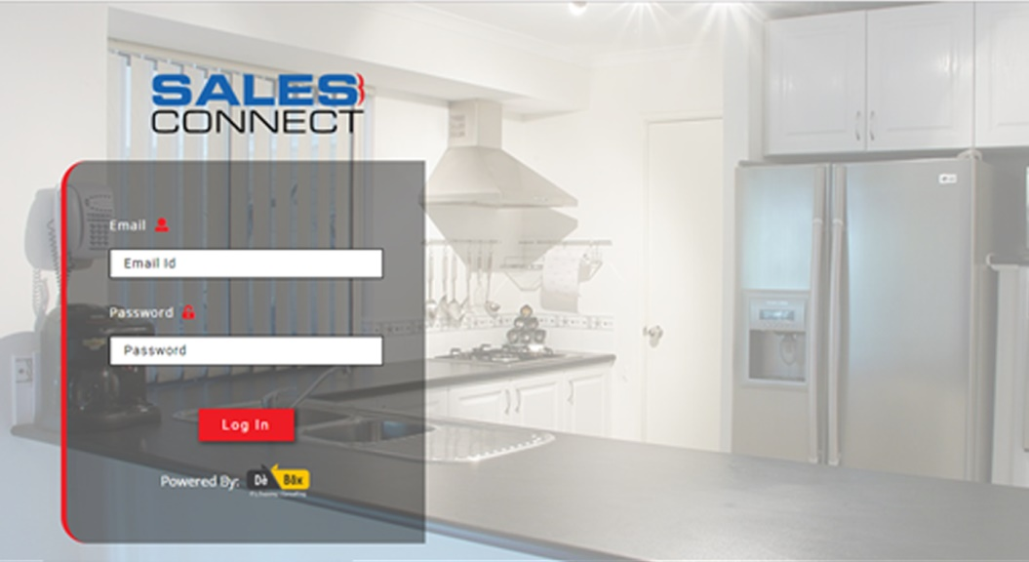
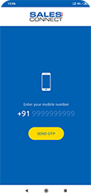
SALES CONNECT LOGIN
Web Application and mobile application
Login Credentials for every individual User.
For security purpose get an OTP on your mobile number or email-id

Slide 9
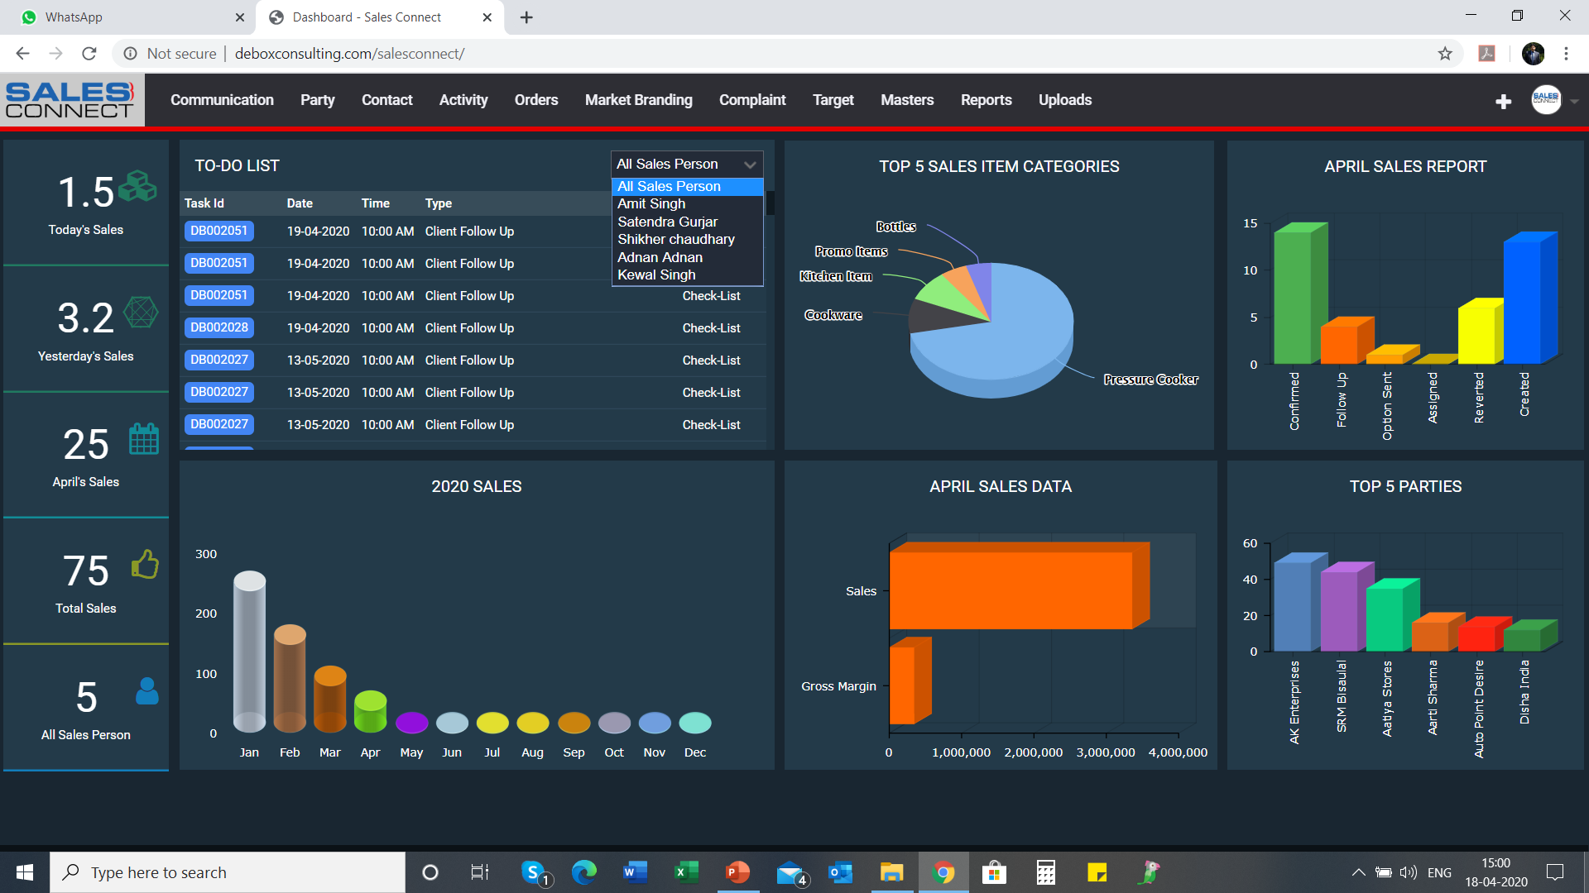
DASHBOARD
Sales Connect Dashboard Represents:
Today’s / Yesterday’s Sales
To Do List of Each Sales Person
Sales & Gross Margin
Month wise Sales
Top 5 Sales Item Categories
Top 5 Parties
Month wise Sales Graph
A Complete Snap view of your organization Productive growth.

Slide 10
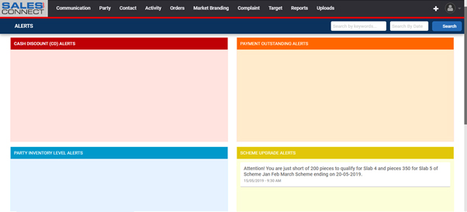
ALERTS
Sales Connect Alert regularly send the notification to parties for any information.
Information For Parties :
Cash Discount (CD) Alerts
Payment Outstanding Alerts
Party Inventory Level Alerts
Scheme Upgrade Alerts

Slide 11
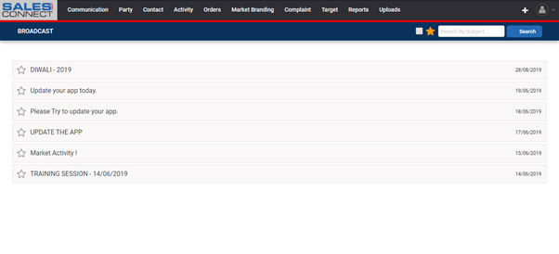
BROADCAST
I don’t get regular timely updates. And my information is not handy at one place.
Now get relevant updates in SALES CONNECT in BROADCAST section as and when they are announced by the company. And they are always in your mobile for quick access. These updates can be about new schemes, new launches, new TVC, Ad campaign, etc.

Slide 12
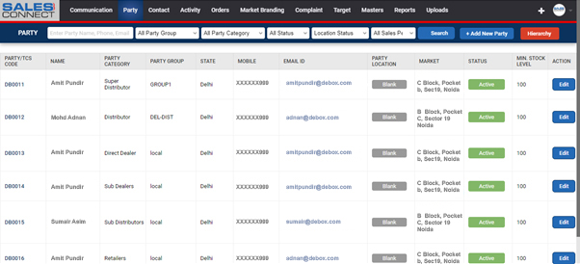
PARTY
Sometimes I lost the data of my parties due to keep record on different- different files. So it create the problem in connecting with the parties for pass-on any information.
Sales Connect provide the solution to Keep record of parties at one place either it is active or Inactive.

Slide 13
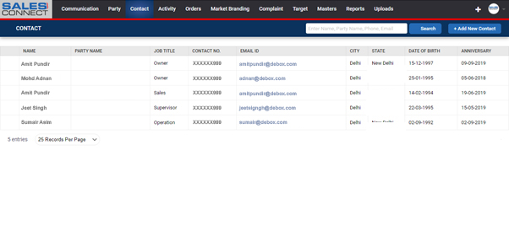
CONTACT
Usually we miss the contact information of our parties contact person detail because it is not one handy so that we miss the greet him on a special day and pass-on any useful information
Sales Connect Keep the Information of party’s contact person and remind you for greet him on a special date. (anniversary wishes, Birthday wishes…etc )

Slide 14
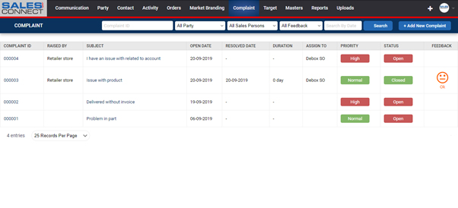
COMPLAINTS
Sometimes issues raised are lost and we don’t know whom to approach
COMPLAINTS MODULE in SALES CONNECT will allow you to raise a complaint, track its resolution and then close it by giving your rating.

Slide 15
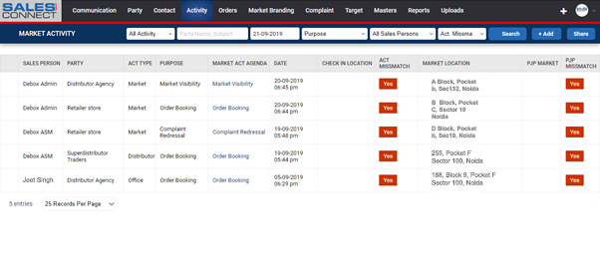
MARKET ACTIVITY
Productive Growth of any organization is depend on the working of Front Line sales Team.
But at the end of month we see that sales team has under achieved their pre- decided target i.e. company’s revenue is not grooming up due to not dedicatedly working by sales team.
Sales Connect provide the solution of this basic problem. It will provide you the Location wise Real time information of your sales team’s activities in the market.

Slide 16
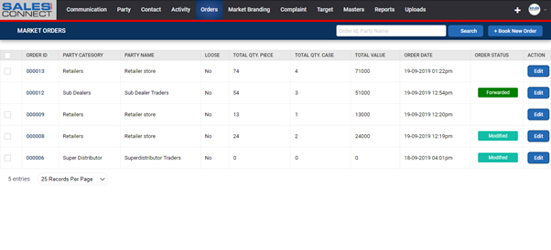
MARKET ORDER
My Orders are sometimes not clearly communicated and I’m not sure of serviceable quantities
MY ORDERS in SALES CONNECT allows you to place orders to company and know about your serviceable quantities.

Slide 17
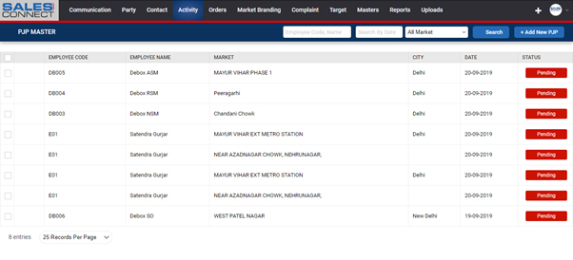
PJP
Sometime fields executives are not clear where they need to go in the market for activity. Due to this they lost the company’s Productive orders.
Sales Connect PJP tells the Sales Team what will the beat plan for next day. Its Increase the working hours of Sales Team and productive order of the company.

Slide 18
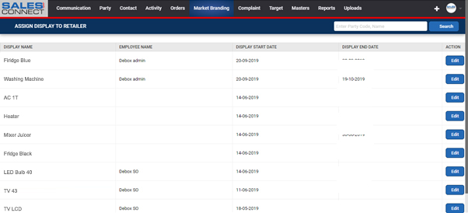
ASSIGN DISPLAY
Branding of a product is very necessary step for Retailer's sales growth and company’s sales growth.
But due to lack of communication with the retailer we lost this opportunity.
Sales connect gives the opportunity to connect with retailer directly for any display related communication.

Slide 19
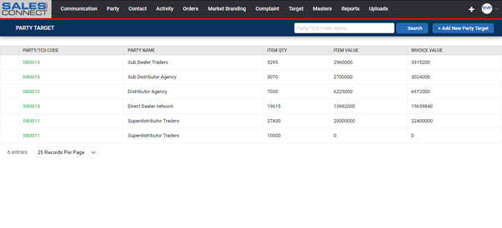
PARTY TARGET
Sometimes Parties have not idea that how much quantity they need to sell of a particular product in a particular time period for outstanding award or scheme announce by the company.
Sales connect tells the parties their Target and update them regularly for their target achievement.

Slide 20
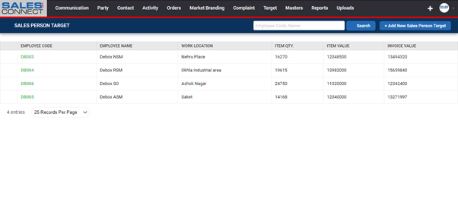
SALES PERSON TARGET
Sales Connect Regularly reminds the Sales executive that what is his sales Target and regularly update him that how much he achieved and how much more he need to achieve in Particular time period.

Slide 21
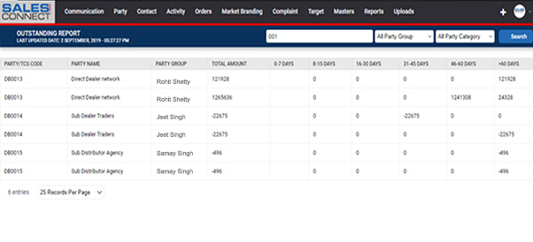
REPORTS
Outstanding Report
Score Report
Sales Report Party Wise
Sales Report ( Sales Person Wise )
Company Inventory Report
Employees Performance Report
Order to Company Report
Party Performance Report
My Market Order Report
Scheme Performance Report

